Slide 1
Hadoop Map-Reduce
2017.5
XenRon

Slide 2
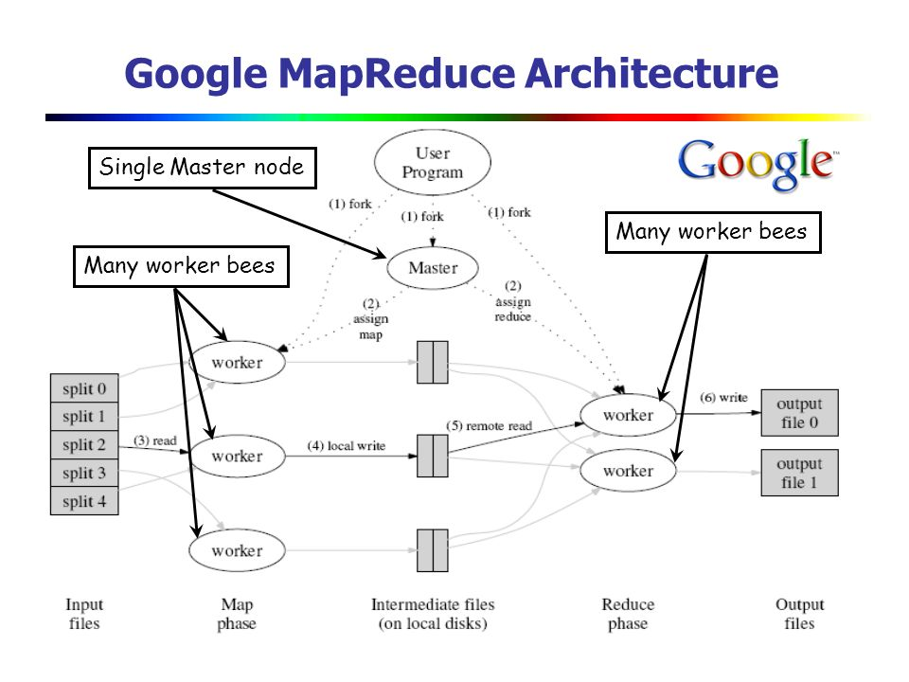
CONTENTS
01
Map-Reduce
02
Computation Modal
03
Word Count
04
Use Case

Slide 3
Review
Review

Slide 4



Review

Slide 5
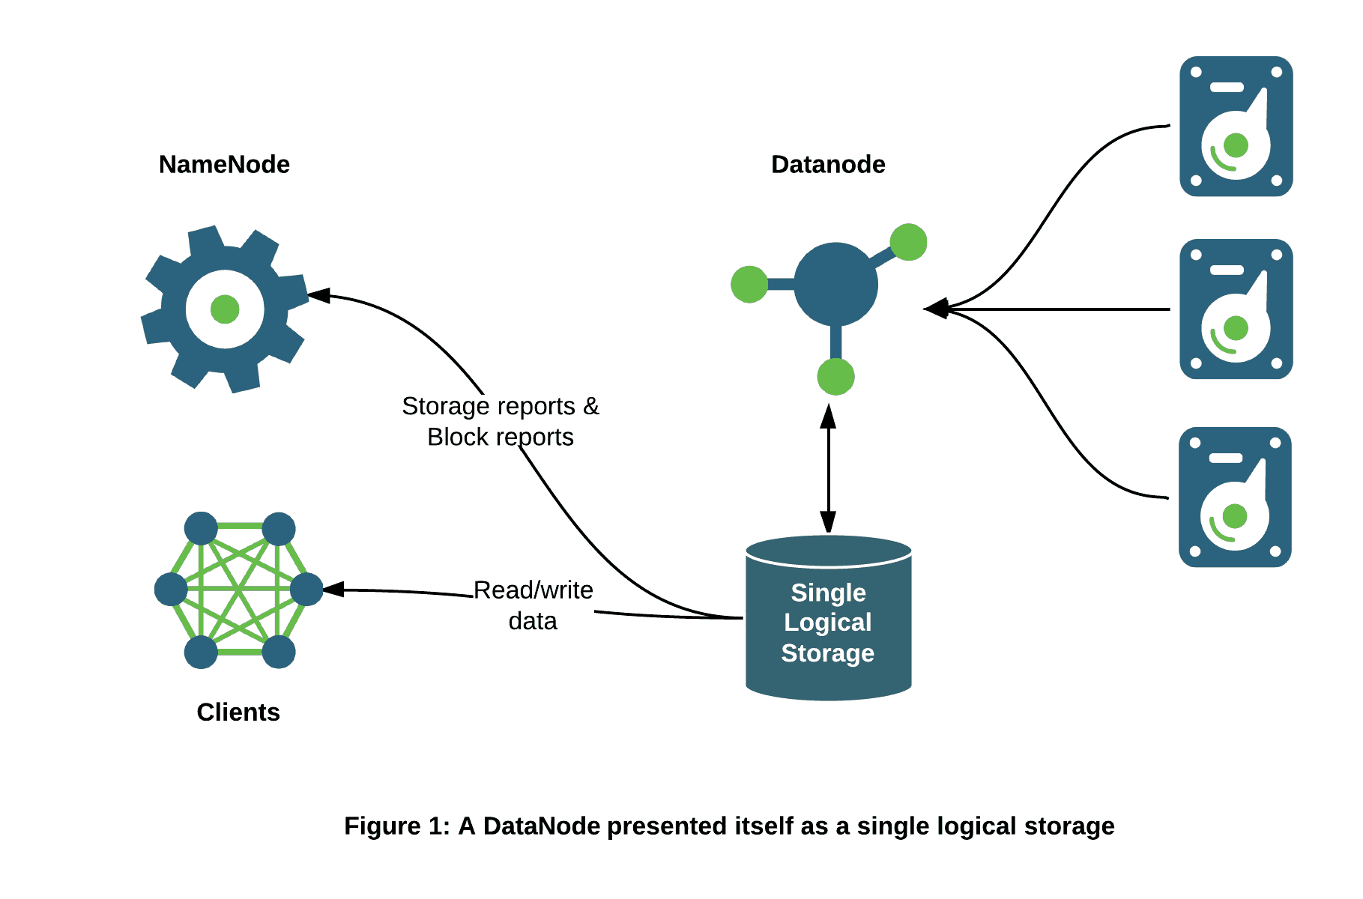
Review

Slide 6
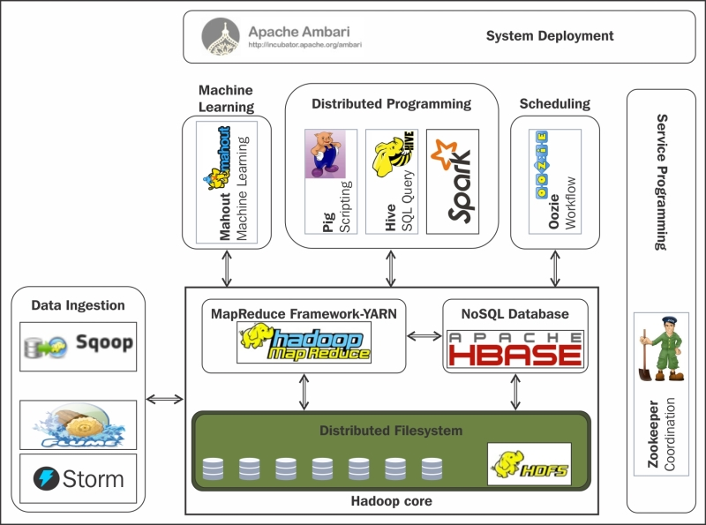
Hadoop Eco System

Slide 7
PART0
Preliminary Topics
事前準備

Slide 8
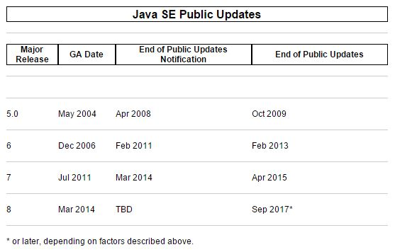

Java
http://www.oracle.com/technetwork/java/eol-135779.html

Slide 9

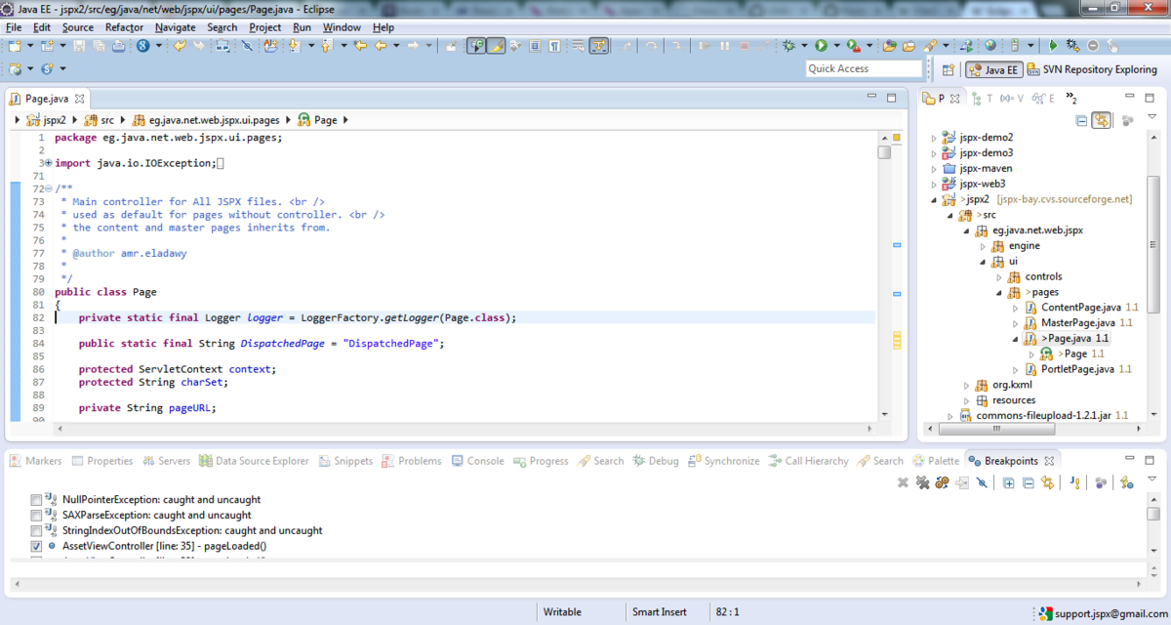
IDE

Slide 10

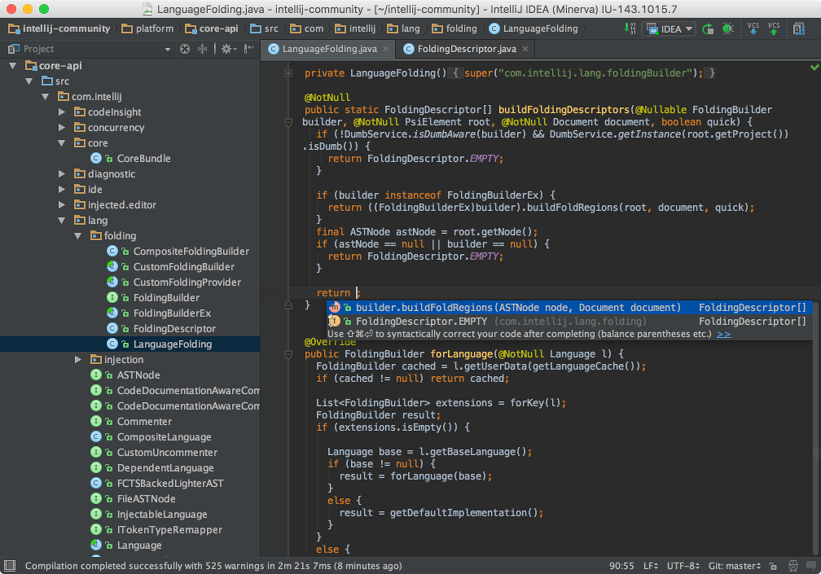
IDE

Slide 11

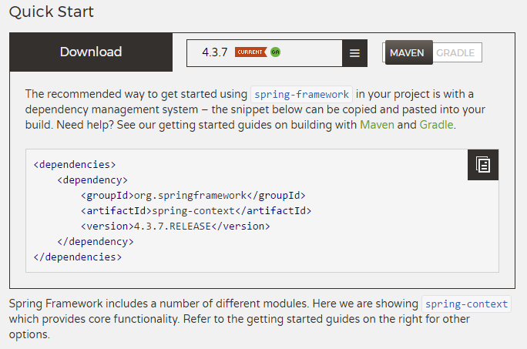


Dependency Management

Slide 12

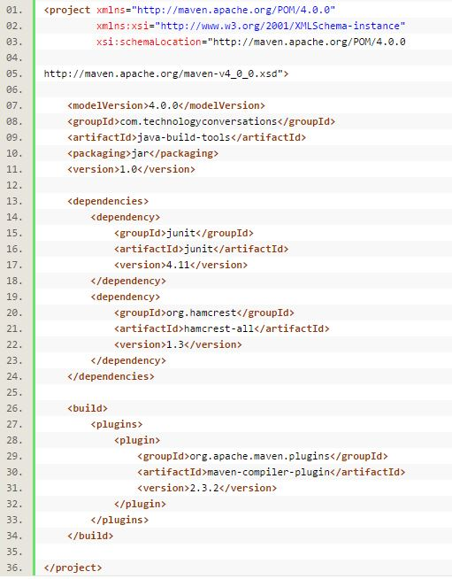
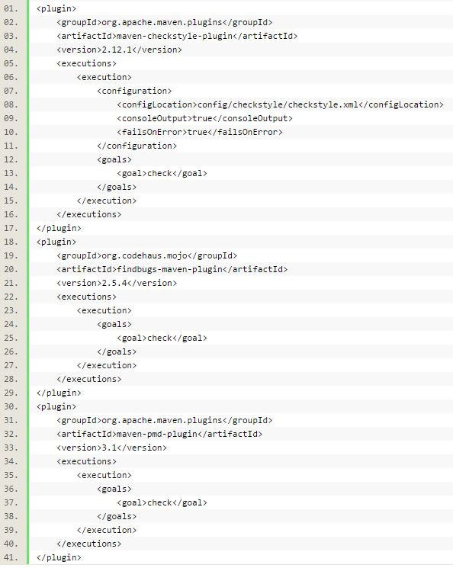
Dependency Management

Slide 13
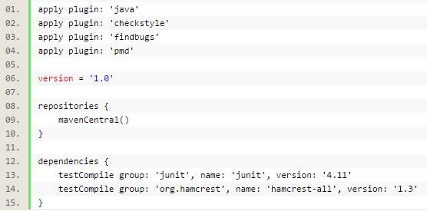
Dependency Management

Slide 14
PART1
Map-Reduce

Slide 15
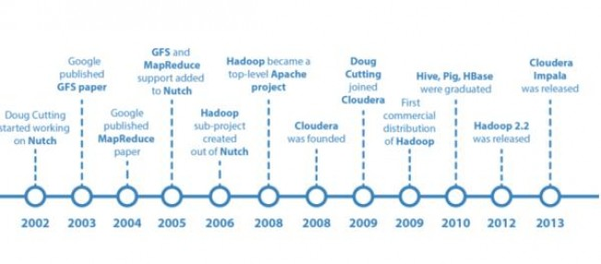
Google

Slide 16
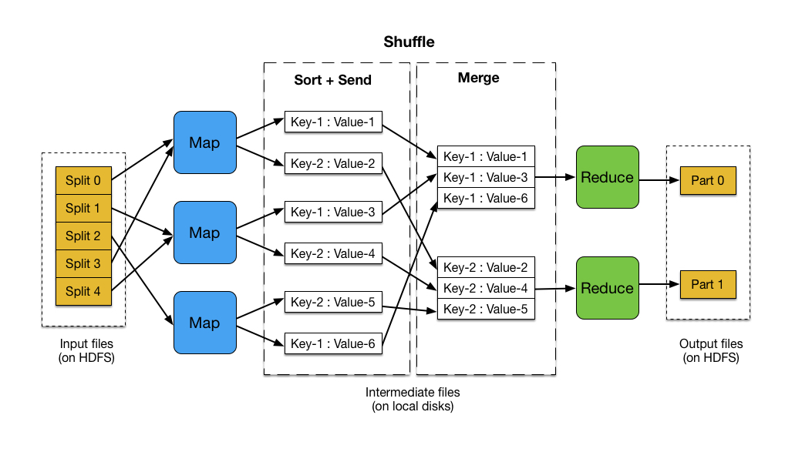
Map Reduce

Slide 17
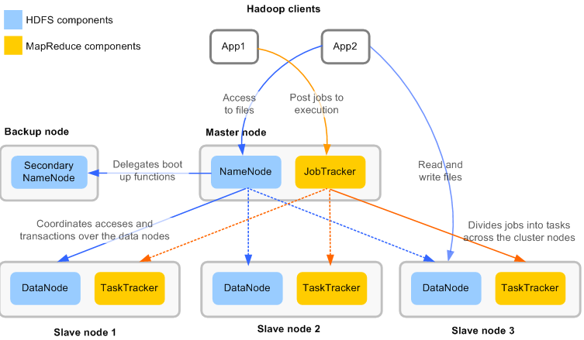
Map Reduce

Slide 18
Map Reduce

Slide 19
Map Reduce

Slide 20
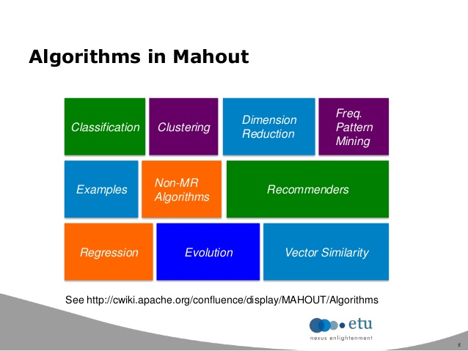
Map Reduce

Slide 21
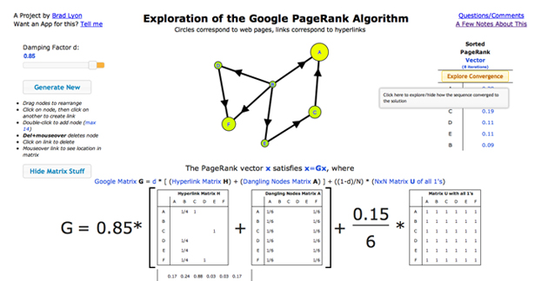
Map Reduce Model #1
Iterator Map-Reduce

Slide 22
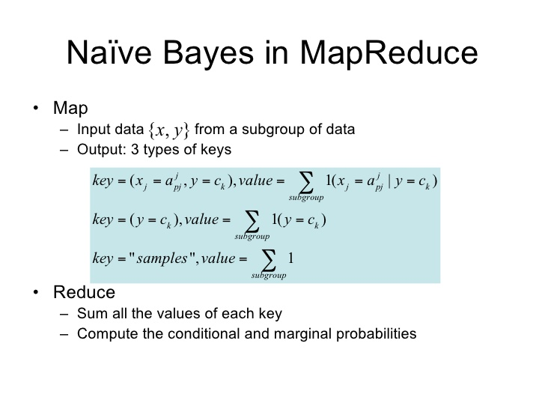
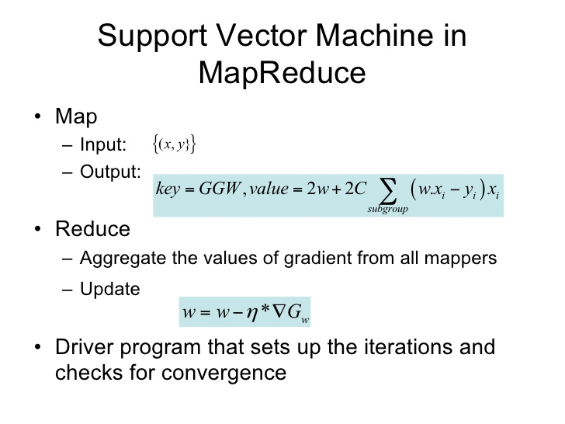
Map Reduce Model #2
Job Control

Slide 23
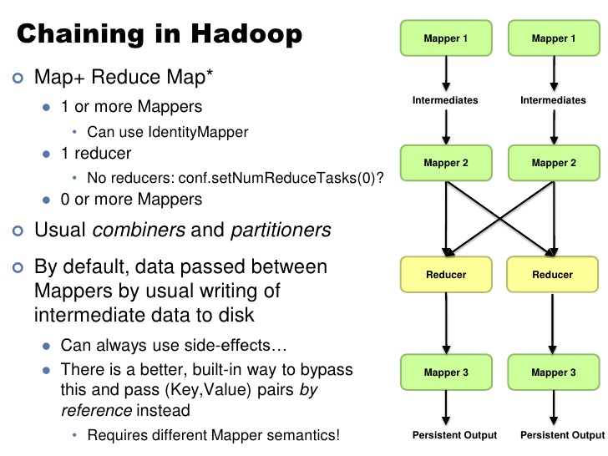
Map Reduce Model #3
Chain-Mapper Chain-Reduce

Slide 24
PART2
Computation Modal
計算模型

Slide 25
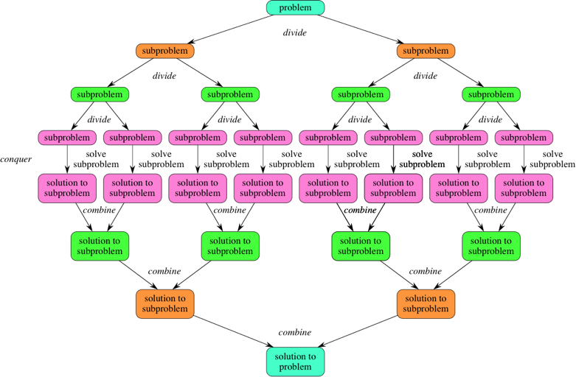
Divide & Conquer

Slide 26
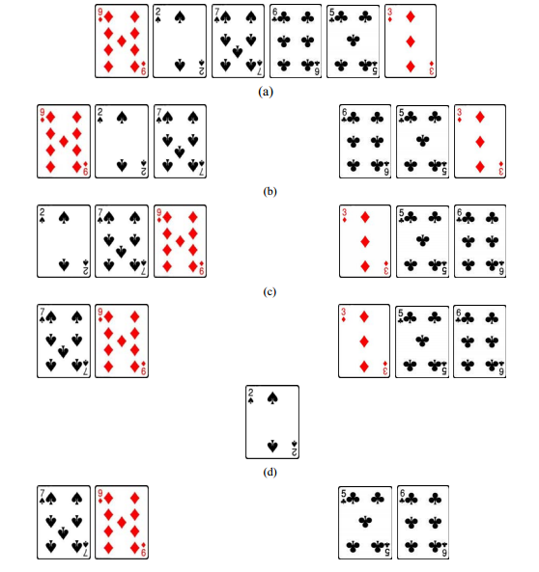
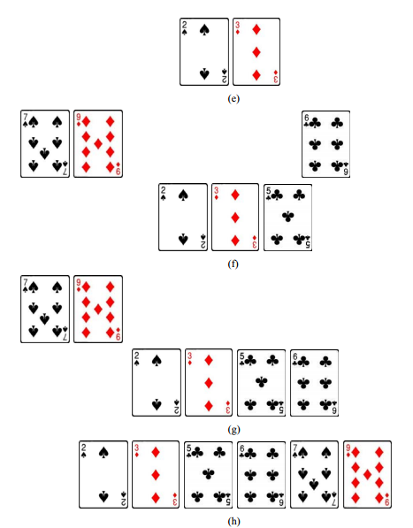
Divide & Conquer

Slide 27
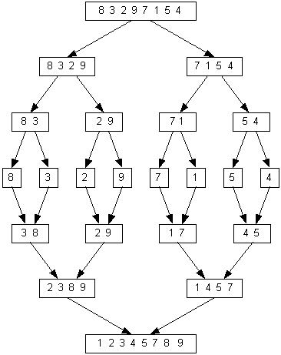
Divide & Conquer

Slide 28
PART3
Word Count

Slide 29
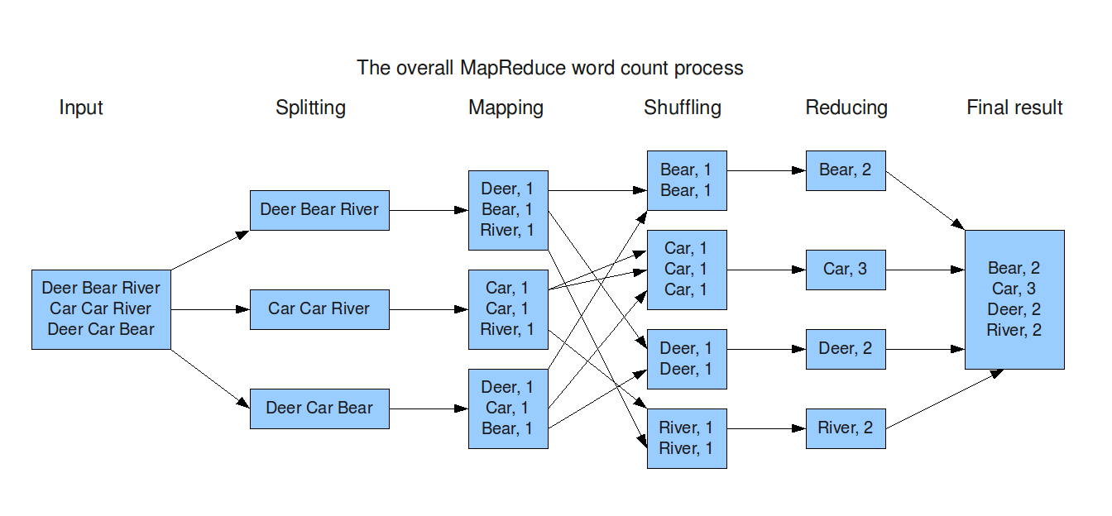
Word Count

Slide 30
Word Count

Slide 31
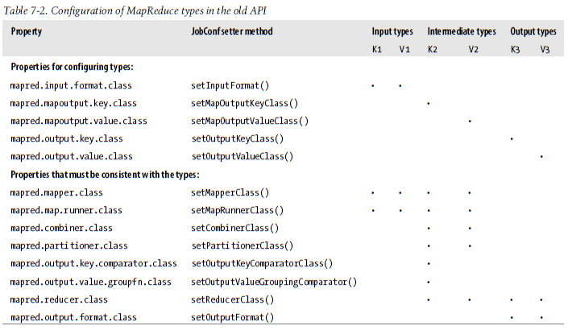
MapReduce API

Slide 32
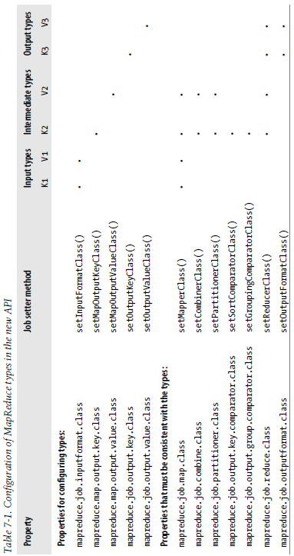
MapReduce API

Slide 33
PART4
Use Case

Slide 34

KPI

Slide 35
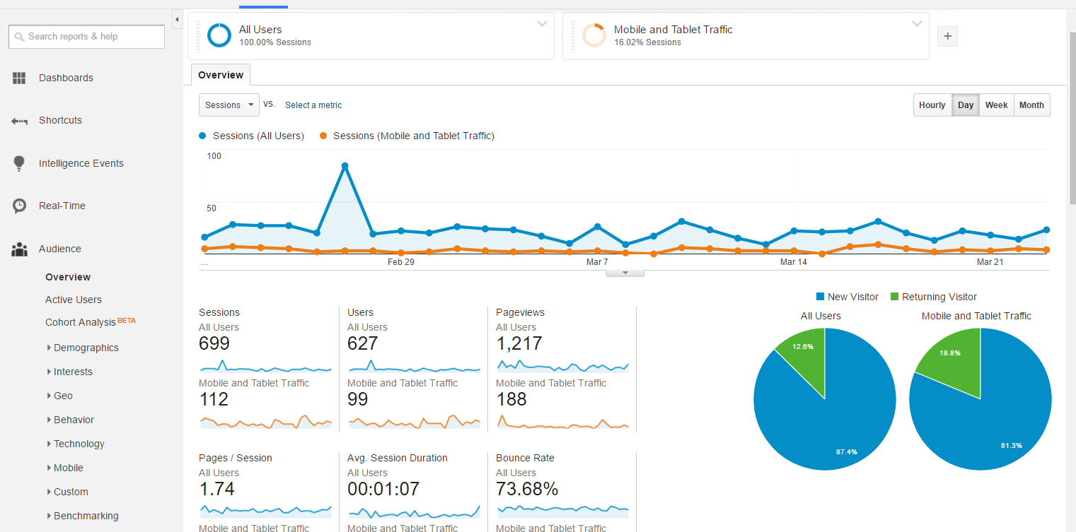
KPI

Slide 36

LBS

Slide 37
PART5
Reference Books

Slide 38
Books

Slide 39
HomeWork

Slide 40
The End

